Slide 1



Cyclistic Data Analysis Case Study
By Prince Williams

Slide 2


What is Cyclistic?
Cyclistic is a fictional bike-share company that is based in Chicago
In 2016, Cyclistic launched a successful bike-share offering. Since then, the program has grown to a fleet of 5,824 bicycles that are geo-tracked and locked into a network of 692 stations across Chicago.
The director of marketing believes the company’s future success depends on maximizing the number of annual memberships.

Slide 3
Purpose of Analysis
How do annual members and casual riders use Cyclistic bikes differently?
Why would casual riders buy Cyclistic annual memberships?
How can Cyclistic use digital media to influence casual riders to become members?

Slide 4
The Data
The data that was used for this study was collected over the course of the 2022 year and it contains data on ride id, bike type, ride length, weekday, and membership tier.
The data was Combined and condensed using a SQL query
R was used to clean data and analyze it to find trends
Tableau allowed us to create visualizations from the data

Slide 5

The Analysis
Most people tend to like rides that last from 10 to 20 mins on average and often utilize the service on Tuesdays.
There seems to be twice the number of members as there are casuals but that doesn’t take into account for members that are using the service multiple times a month or for multiple months at a time or casuals that have converted to members.

Slide 6

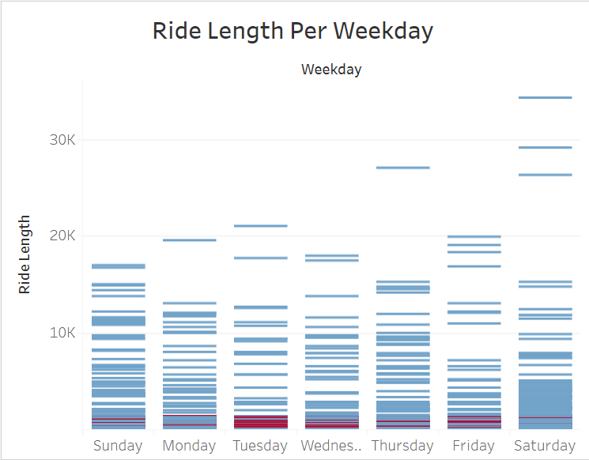
The Analysis Contd.
Week days are very popular for members while casuals like to populate the weekends and some of the weekdays.
Tuesday is indeed a very popular day however Saturday, Sunday, and Monday are popular days as well with it waning as the work week goes on.

Slide 7
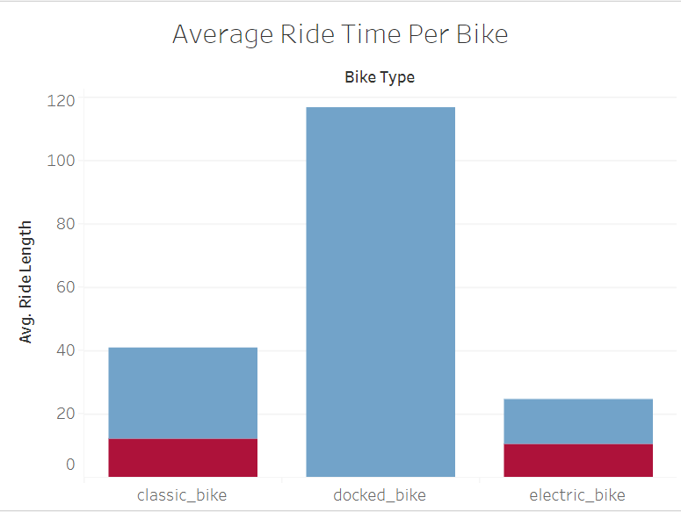
The Analysis Contd.
People used the docked bikes almost 3 times longer than any other bike types well as it was the one that is almost exclusively used by casuals
The classic bike had the 2nd longest avg ride time for users with electric bike being last.
Most people tend to prefer classic or the docked bike over the electric bike for a bit longer rides

Slide 8
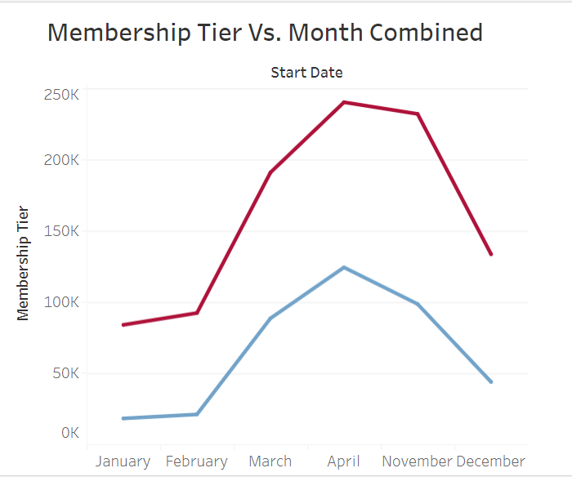
The Analysis Contd.
It seems to be a near direct relationship between the number of casual users and the number of users using the service.
This can infer casuals are starting to convert to members and are growing up into the summer.
Things start to level off into the winter months and stay steady until it approaches springtime.

Slide 9
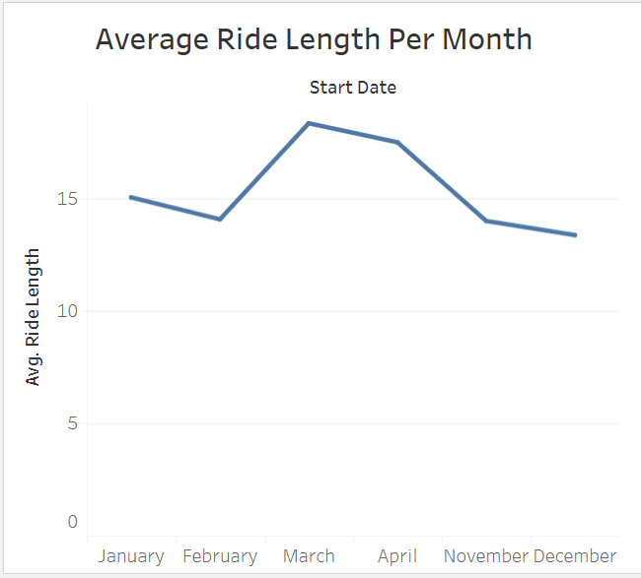
The Analysis Contd.
Averages like to be around the 15-minute mark with things going up or down due to various reasons.
As time gets closer to March, more people like to ride longer and while it continue to level off after that point.

Slide 10
The Gameplan
In order to increase the number of casual users that you attract, you must first appeal and advertise towards casuals.
Casuals like to ride during the weekends, so you can offer promotions that promote people to trying to use the service on the weekends
Advertising in the spring and summer can help as well since people are more active after staying home for the colder months
However, to increase the number of members that you have, there needs to be something done about the amount of people that drop out at the second half of the year as well.

Slide 11
Questions Revisited
How do annual members and casual riders use Cyclistic bikes differently?
Members seem to like to use classic/electric models and ride for a shorter amount of time.
Members like to use the service on weekdays meanwhile casual users use the service mostly on weekends.

Slide 12
Questions Revisited
Why would casual riders buy Cyclistic annual memberships?
One reason why cyclistic riders buy annual memberships might be because the price difference makes sense to them.
Another reason is that they are able to take advantage of benefits that a annual membership offers them more than just staying a casual.
Commute might be easier on bikes which allows people to save money while still having reliable transportation.

Slide 13
Questions Revisited
How can Cyclistic use digital media to influence casual riders to become members?
Cyclcistic can capitalize on the time leading to months where they are popular to launch an ad campaign to promote their product and get as many eyes on it as possible.
Many people like to get out and ride on the weekends during the spring/summer, so appealing to their sensibilities can provide for a big boost to the casual user base.

Slide 14
Conclusions
We need to focus on growing the amount of casual users we have while increasing the retention rates of our current members.
Many casuals are weekend riders and annual members seem to enjoy riding on weekdays for the most part, so incorporating help for both can help the best of both worlds and improve the rider experience.
Focusing on the peak months while minimizing droughts in user usage will be key in determining the future success of cyclistic.

Slide 15
Thank you for Listening!
End of Presentation

